Slide 1

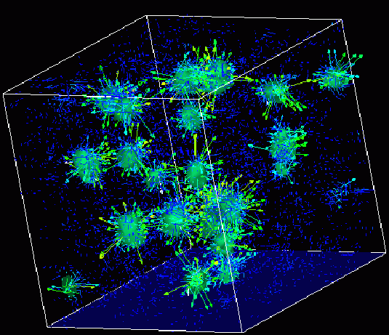

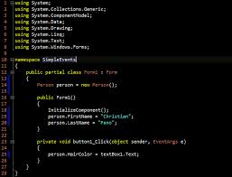
Survey of
Scientific Computing
(SciComp 301)
Dave Biersach
Brookhaven National Laboratory
dbiersach@bnl.gov
Session 23
Difference Tables,
Least Squares

Slide 2
Session Goals
Determine the underlying generator for a sequence of integers (the functional equation)
Fit a quadratic curve to a set of observations to interpolate the resulting values that lie between those observations
Understand how to create difference tables in the open source (and free) LibreOffice Calc spreadsheet program
Appreciate % relative error as a measure of the goodness of fit between a model and the experimental data
Fit a curve using the Method of Least Squares
Derive the least squares equations using partial derivatives to calculate the coefficients of a quadratic model

Slide 3
Difference Tables – The Big Picture
A difference table calculates the delta between successive values (in the range) of a given function
For every higher power of the independent variable (in the domain) we add another difference column
Difference column #2 is the gap between successive values of difference column #1, etc.
We keep adding difference columns until the value in the rightmost column is the same for every row – this is called achieving a steady state

Slide 4
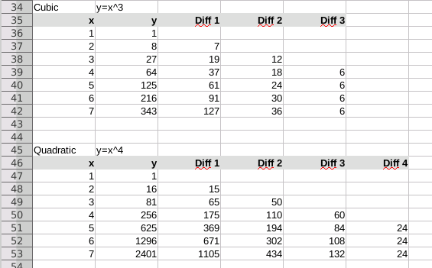
Difference Tables – The Big Picture
There will be no values in the blue cells
We keep adding difference columns until the rightmost column reaches a steady value

Slide 5
Creating a Spreadsheet
A spreadsheet is a flexible computing tool that allows you to enter data and write formulas to operate on that data
Everything is based on the concept of a “cell” that has a unique column (letter) and row (number) address
A formula entered in one cell can reference data in one or more other cells by using cell addresses, or by using a range of cell addresses
When source data cells are updated, the spreadsheet automatically recalculates all dependent formula cells
Graphs can be created to depict the values in cells

Slide 6

Creating a Spreadsheet
Click icon to launch LibreOffice “Calc” spreadsheet

Slide 7
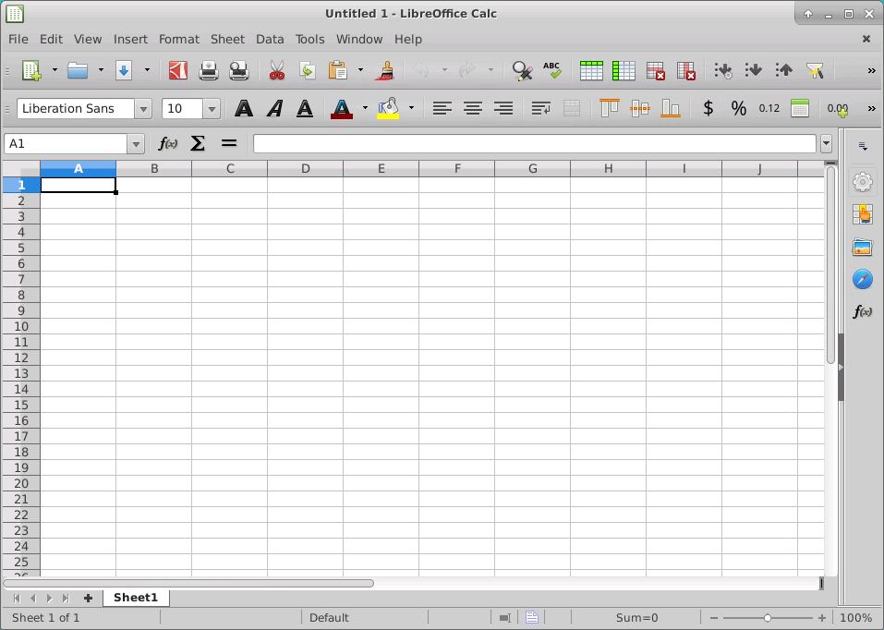
Lab 1 - Creating a Spreadsheet
Bold, Italic, Underline a cell
Left, Center, Right Justify a cell
Change a cell's background color
This is cell A1

Slide 8
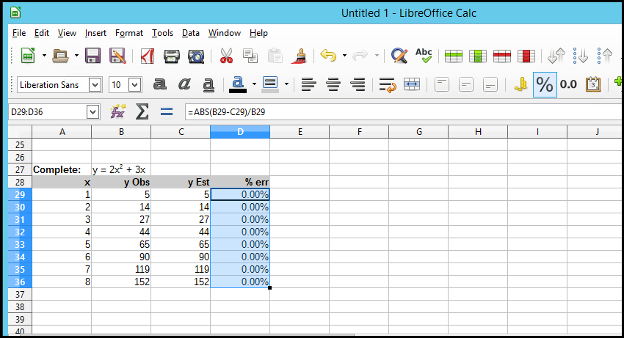
Changing a Cell's Number Format
Highlight a range and click the % icon to format the numbers as percentages

Slide 9
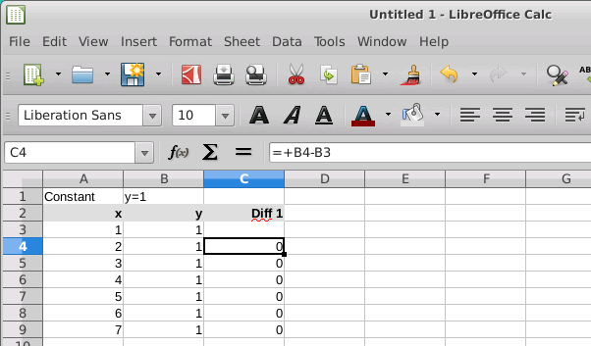
Lab 1 – Constant Difference Table
Make your columns A and B (and rows 1 to 9)
look just like this!

Slide 10
Lab 1 – Constant Difference Table
To enter a formula cell, press +, then use the arrow keys to select the source data cells. Press ENTER when done with the formula

Slide 11
Lab 1 – Constant Difference Table
Cell C4 is a formula using relative cell addressing

Slide 12
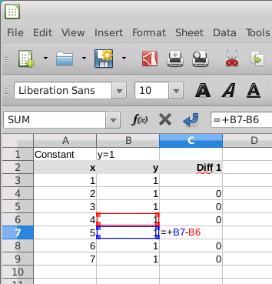
Lab 1 – Constant Difference Table
To check a formula cell, press F2 to edit the formula – color coding then identifies the cells

Slide 13
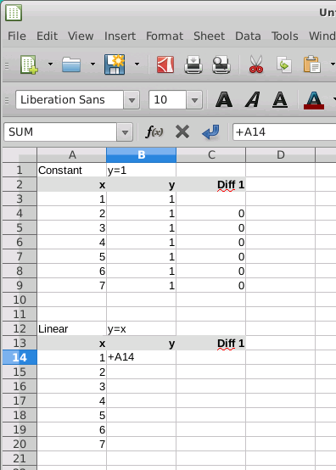
Lab 1 – Linear Difference Table
Create a new table called Linear as shown (3 columns)

Slide 14
Lab 1 – Linear Difference Table
To enter a formula cell, press +, then use the arrow keys to select the source data cells. Press ENTER when done with the formula

Slide 15
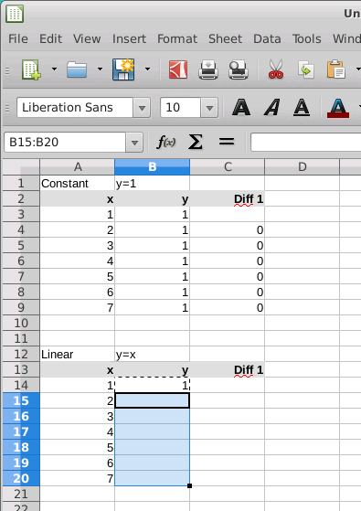
Lab 1 – Linear Difference Table
To copy a formula to other cells, highlight the source cell, press “Control + C” to copy, then use SHIFT + arrow keys to highlight a destination range, and then press ENTER to paste the formula

Slide 16
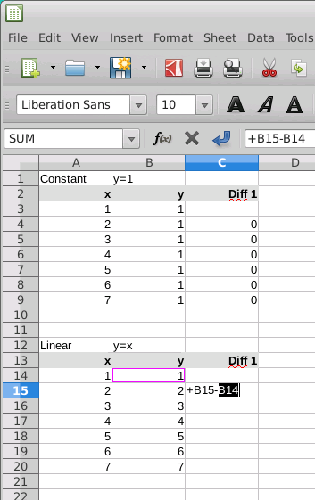
Lab 1 – Linear Difference Table
Create the Diff 1 column using the difference between the left-adjacent cell and the cell above that one, then copy that formula down the remaining cells in the Diff 1 column.

Slide 17
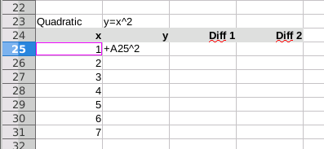
Lab 1 – Quadratic Difference Table
Create a new table called Quadratic as shown (4 columns)

Slide 18
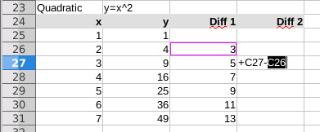
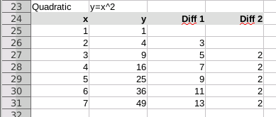
Lab 1 – Quadratic Difference Table
Create the y column with the exponent 2 and then copy down
Add the Diff 1 & Diff 2 columns and formulas and then copy down
The completed quadratic difference table

Slide 19
Lab 1 – Cubic and Quartic Tables
Add the Cubic and Quartic Difference Tables

Slide 20
Difference Tables – The Big Picture
A difference table calculates the delta between successive values (in the range) of a given function
For every higher power of the independent variable (in the domain) we add another difference column
Difference column #2 is the gap between successive values of difference column #1, etc.
We keep adding difference columns until the value in the rightmost column is the same for every row – this is called achieving a steady state
The cubic table needed 3 difference columns – the quartic table needed 4 difference columns to achieve steady state

Slide 21
Difference Tables – The Big Picture
Keep adding difference columns until the rightmost column reaches a steady value

Slide 22


Difference Tables – What They Reveal
Expected Steady Difference for $(1)x^{n}=n!$
$$(1)x^{4}=4!=4×3×2×1=24$$

Slide 23
Difference Tables – What They Reveal
If we believe a given a set of observations obeys an unknown general power law, we can use difference tables to systematically reveal this hidden functional generator
We start by “guessing” the highest power of x that would likely be in the underlying generator
We compare the expected steady state values for each power of x with the our observed values
As we determine the coefficient for each decreasing power of x, we begin to expose (one term at a time) the underlying functional equation that generated the original sequence

Slide 24
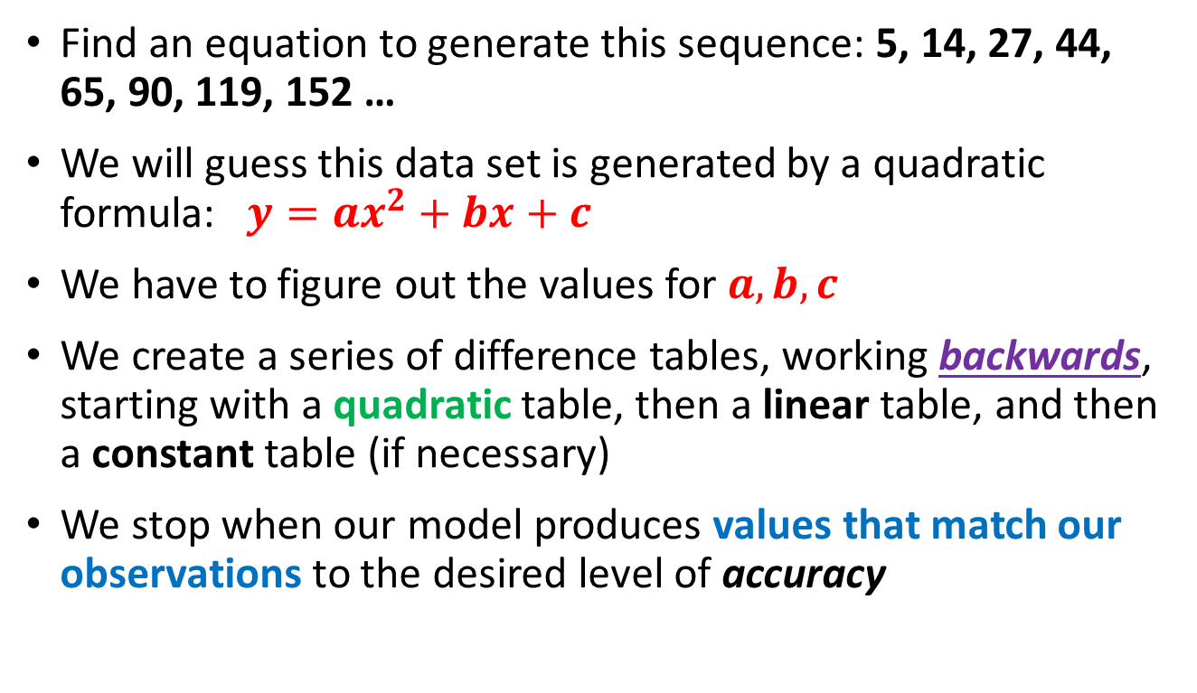
Lab 2
Find an equation to generate this sequence: 5, 14, 27, 44, 65, 90, 119, 152 …
We will guess this data set is generated by a quadratic formula: $y=ax^{2}+bx+c$
We have to figure out the values for $a,b, c$
We create a series of difference tables, working backwards, starting with a quadratic table, then a linear table, and then a constant table (if necessary)
We stop when our model produces values that match our observations to the desired level of accuracy

Slide 25
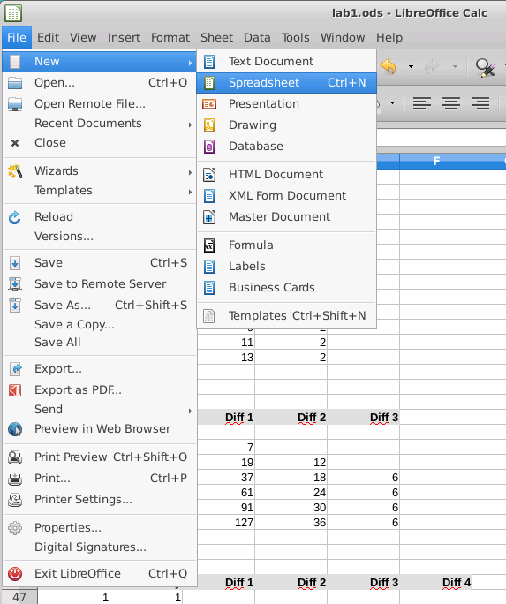
Lab 2 – Create a new Spreadsheet

Slide 26
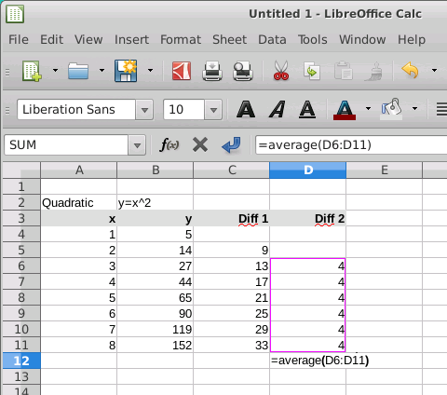


Lab 2 – Quadratic Difference Table
The B column holds the observations
Create a new table called Quadratic (calculate both
Diff columns)

Slide 27
Calculating the Mean Steady Difference
Enter =average then select the range of cells to include in the formula – do this for every table from now on

Slide 28
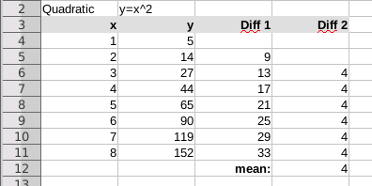
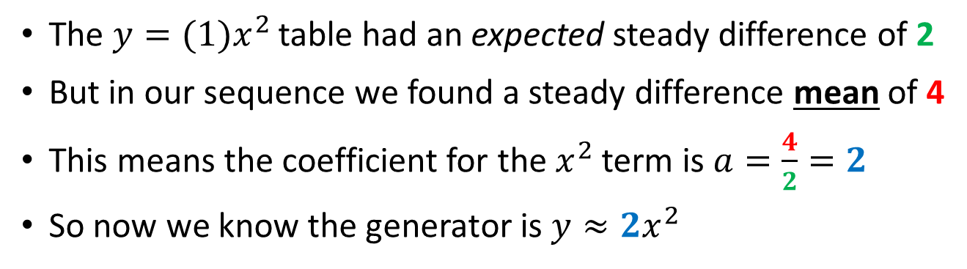
Calculating the Coefficient of each Term
The $y={(1)x}^{2}$ table had an expected steady difference of 2
But in our sequence we found a steady difference mean of 4
This means the coefficient for the $x^{2}$ term is $a=\frac{4}{2}=2$
So now we know the generator is $y≈2x^{2}$

Slide 29
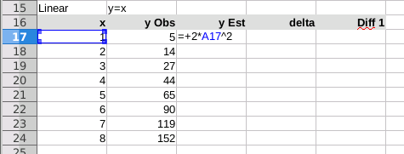

Lab 2 – Linear Difference Table
Create a new table called Linear
Add the y Est and delta columns
The y Obs column holds the observed values

Slide 30
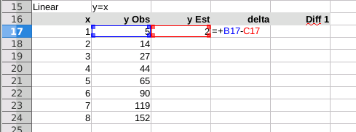
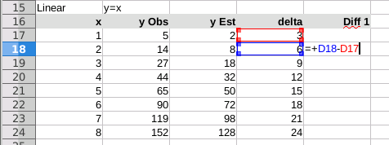
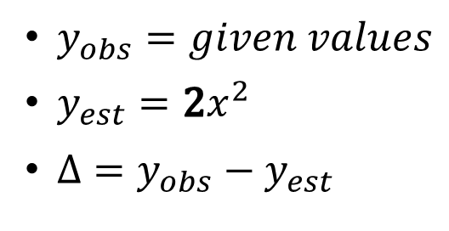
Delta = Observed - Expected
$y_{obs}=given values$
$y_{est}=2x^{2}$
$Δ=y_{obs}−y_{est}$
Add the Diff 1 column and formula, then copy that down all rows

Slide 31
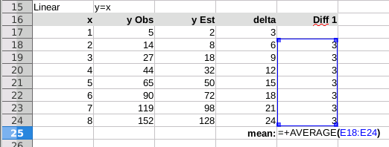
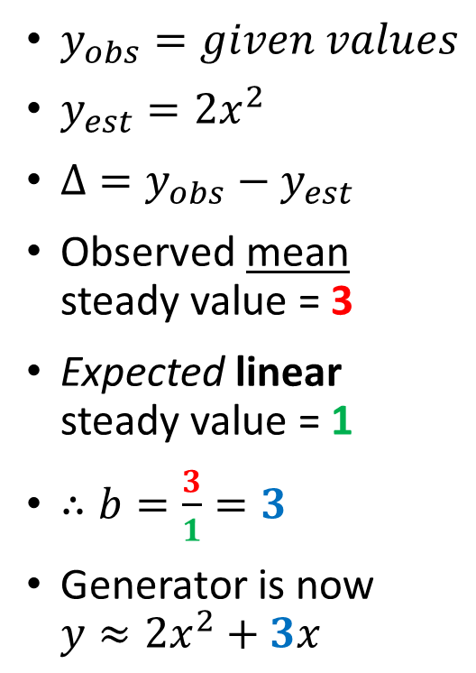
Delta = Observed - Expected
$y_{obs}=given values$
$y_{est}=2x^{2}$
$Δ=y_{obs}−y_{est}$
Observed mean steady value = 3
Expected linear steady value = 1
$∴b=\frac{3}{1}=3$
Generator is now $y≈{2x}^{2}+3x$

Slide 32
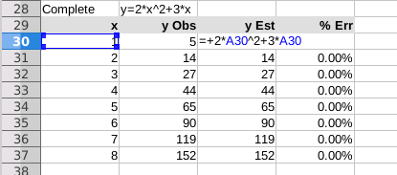
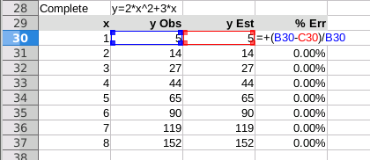

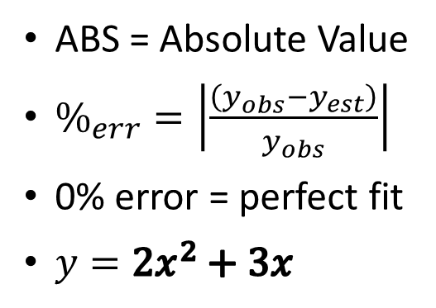
% Relative Error
Create a new table called Complete
ABS = Absolute Value
$\%_{err}=\left|\frac{\left(y_{obs}−y_{est}\right)}{y_{obs}}\right|$
0% error = perfect fit
$y=2x^{2}+3x$
$2x^{2}+3x$ generates
5, 14, 27, 44, 65, 90, 119, 152 …

Slide 33
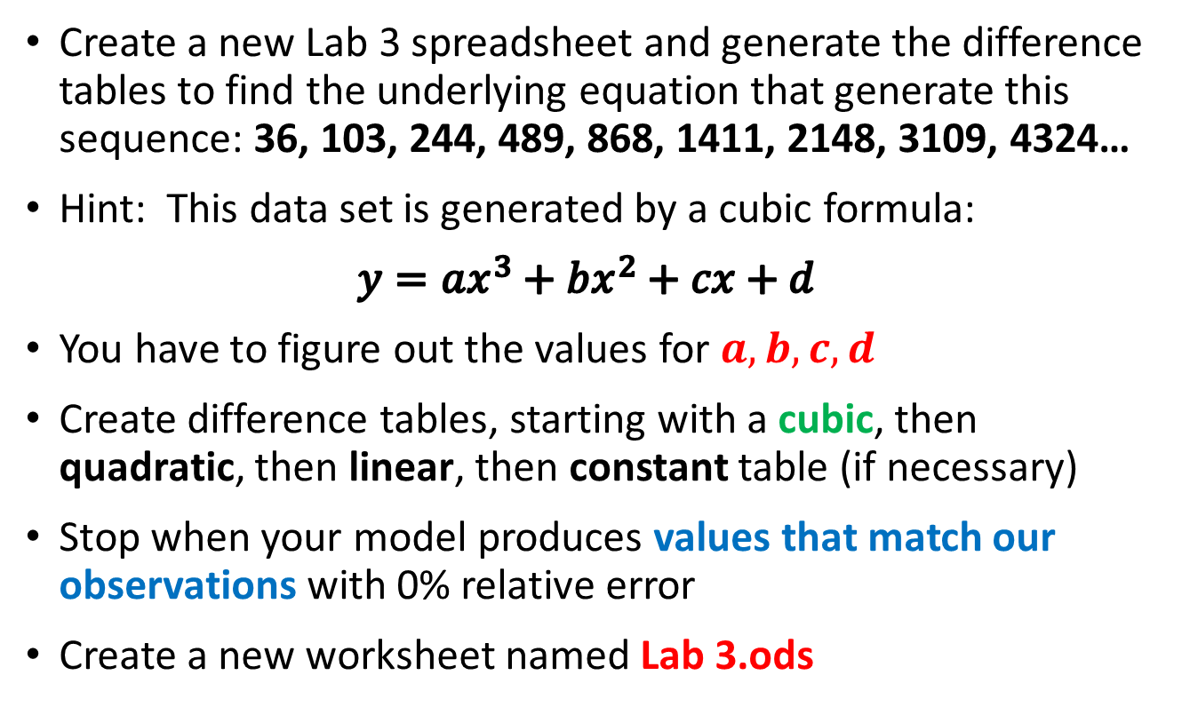
Lab 3
Create a new Lab 3 spreadsheet and generate the difference tables to find the underlying equation that generate this sequence: 36, 103, 244, 489, 868, 1411, 2148, 3109, 4324…
Hint: This data set is generated by a cubic formula:
$$y=ax^{3}+bx^{2}+cx+d$$
You have to figure out the values for $a,b, c,d$
Create difference tables, starting with a cubic, then quadratic, then linear, then constant table (if necessary)
Stop when your model produces values that match our observations with 0% relative error
Create a new worksheet named Lab 3.ods

Slide 34
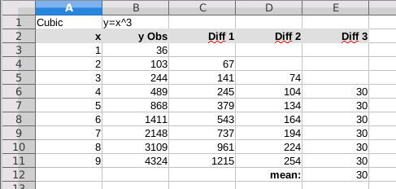

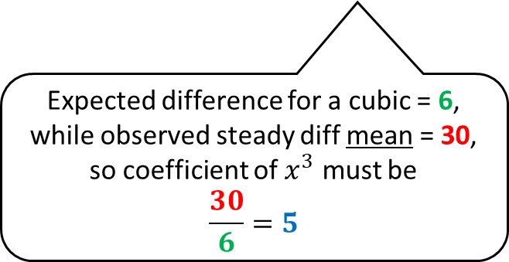
Lab 3 – Cubic Difference Table
Expected difference for a cubic = 6, while observed steady diff mean = 30, so coefficient of $x^{3}$ must be
$$\frac{30}{6}=5$$
Create a new table called Cubic (calculate all three
Diff columns)
So far $… y=5x^{3}$

Slide 35
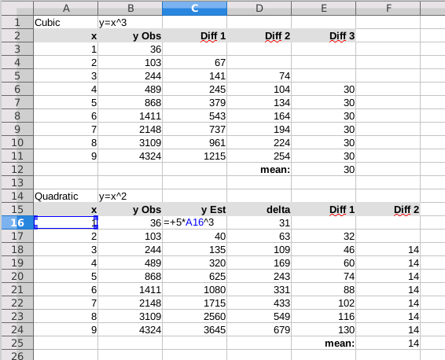

Lab 3 – Quadratic Difference Table
Create a new table called Quadratic
Add the y Est, delta, and both Diff columns
So far $… y=5x^{3}$

Slide 36

Lab 3 – Quadratic Difference Table
Expected difference for a quadratic = 2, while observed steady diff mean = 14, so coefficient of $x^{2}$ must be
$$\frac{14}{2}=7$$
Now so far $… y≈5x^{3}+7x^{2}$

Slide 37
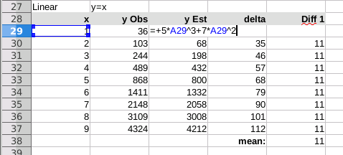

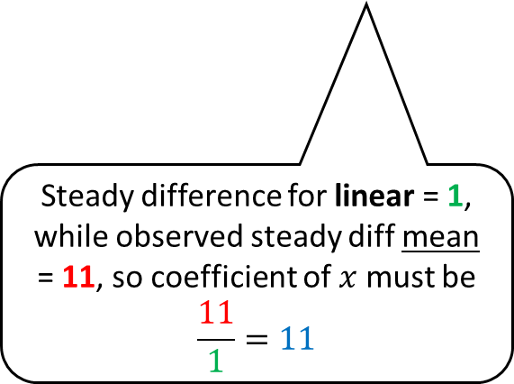
Lab 3 – Linear Difference Table
Remember to add the new quadratic term to the estimated y function
Steady difference for linear = 1, while observed steady diff mean = 11, so coefficient of $x$ must be
$$\frac{11}{1}=11$$
Now so far $… y≈5x^{3}+7x^{2}+11x$

Slide 38
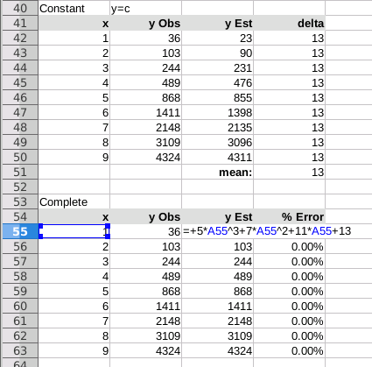
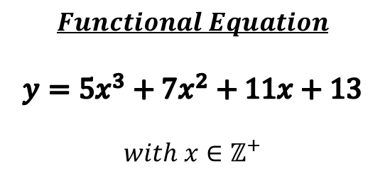
Lab 3 – Constant Difference Table
If the delta values are all the same, then that value is the final constant term
$$Functional Equation$$
$$y=5x^{3}+7x^{2}+11x+13$$
$$with x∈ℤ^{+}$$
Generates the sequence:
36, 103, 244, 489, 868, 1411, 2148, 3109, 4324…

Slide 39

Lab 4
This case study will use data from an experiment that measured the counter on a tape machine vs. the elapsed time the tape was played
Ideally there would be a linear relationship between these two variables
But due to the constantly changing circumference of a tape reel as it is played, the relationship is non-linear

Slide 40
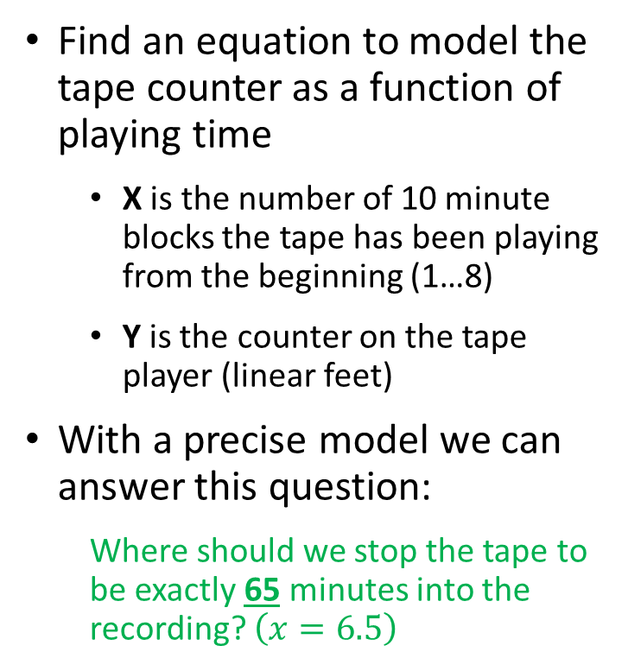
Lab 4
Find an equation to model the tape counter as a function of playing time
X is the number of 10 minute blocks the tape has been playing from the beginning (1…8)
Y is the counter on the tape player (linear feet)
With a precise model we can answer this question:
Where should we stop the tape to be exactly 65 minutes into the recording? $\left(x=6.5\right)$

Slide 41
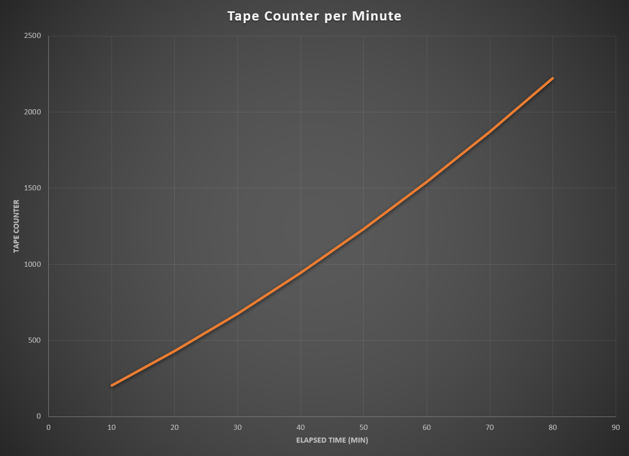
Lab 4
$$Assume$$
$$y=ax^{2}+bx+c$$

Slide 42
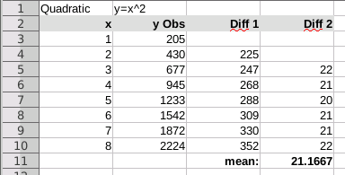
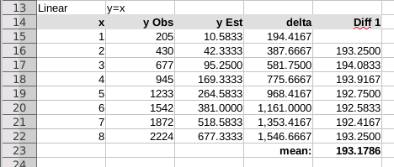
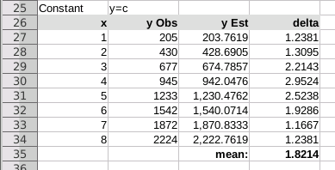
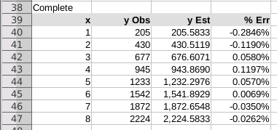
Lab 4 – Difference Tables
$$y_{est}=10.5833x^{2}+193.1786x+1.8214$$

Slide 43
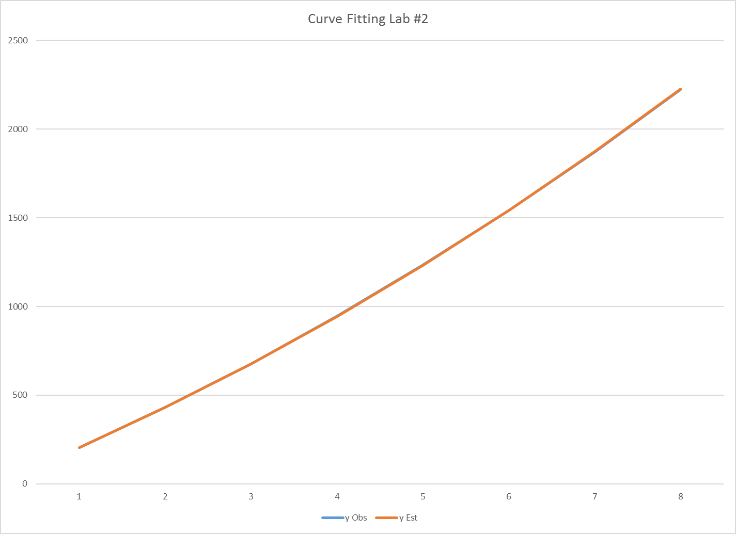
Lab 4 – Model Predictions
$$y=10.5833x^{2}+193.1786x+1.8214$$
1704
Where should we stop the tape to be exactly 65 minutes into the recording?
$$10.5833{\left(6.5\right)}^{2}+193.1786\left(6.5\right)+1.8214=1704$$

Slide 44
Lab 5 - Method of Least Squares
Developed by Gauss, least squares finds the coefficients of a polynomial of a given degree that approximates a set of observations with minimal variance from the data
The modeler selects a curve whose general shape matches the trend of the data
The partial derivatives of the chosen polynomial are then determined, leading to a system of linear equations that can be solved using matrices and Cramer’s Rule
The coefficients of each term of the model polynomial are then determined, allowing us to estimate the unknown function value at any point within the given domain

Slide 45
Lab 5 - Method of Least Squares
$$Assume$$
$$y=ax^{2}+bx+c$$

Slide 46
Lab 5 - Method of Least Squares
$$Minimize S= \sum_{i=1}^{n}{{\left[y_{i}−\left(ax_{i}^{2}+bx_{i}+c\right)\right]}^{2}}$$
$$\left(y−{ax}^{2}−bx−c\right)\left(y−{ax}^{2}−bx−c\right)$$
$$y^{2}−ax^{2}y−bxy−cy$$
$$−ax^{2}y +a^{2}x^{4}+abx^{3}+acx^{2}$$
$$−bxy +abx^{3} +b^{2}x^{2}+bcx$$
$$−cy +acx^{2} +bcx+c^{2}$$
$$S=y^{2}−2ax^{2}y−2bxy−2cy+a^{2}x^{4}+2abx^{3}+2acx^{2}+b^{2}x^{2}+2bcx+c^{2}$$
Note: we will set aside the summation operator for now…

Slide 47
Lab 5 - Method of Least Squares
$$Minimize S= \sum_{i=1}^{n}{{\left[y_{i}−\left(ax_{i}^{2}+bx_{i}+c\right)\right]}^{2}}$$
$$S=y^{2}−2ax^{2}y−2bxy−2cy+a^{2}x^{4}+2abx^{3}+2acx^{2}+b^{2}x^{2}+2bcx+c^{2}$$
For S to have a minimum, these partial derivatives must exist:
$$\frac{∂S}{∂a}=0,\frac{∂S}{∂b}=0,\frac{∂S}{∂c}=0$$
$$\frac{∂S}{∂a}=−2x^{2}y+2ax^{4}+2bx^{3}+2cx^{2}=0$$
$$\frac{∂S}{∂b}=−2xy+2ax^{3}+2bx^{2}+2cx=0$$
$$\frac{∂S}{∂c}=−2y+2ax^{2}+2bx+2c=0$$

Slide 48
Lab 5 - Method of Least Squares
$$Minimize S= \sum_{i=1}^{n}{{\left[y_{i}−\left(ax_{i}^{2}+bx_{i}+c\right)\right]}^{2}}$$
$$\frac{∂S}{∂a}=−2x^{2}y+2ax^{4}+2bx^{3}+2cx^{2}=0$$
Divide through by the GCD of all terms
Move all terms not containing a, b, or c
to the RHS
$$\left(x^{4}\right)a+\left(x^{3}\right)b+\left(x^{2}\right)c=x^{2}y$$
$$\frac{∂S}{∂b}=−2xy+2ax^{3}+2bx^{2}+2cx=0$$
$$\left(x^{3}\right)a+\left(x^{2}\right)b+\left(x\right)c=xy$$
$$\frac{∂S}{∂c}=−2y+2ax^{2}+2bx+2c=0$$
$$\left(x^{2}\right)a+\left(x\right)b+c=y$$

Slide 49

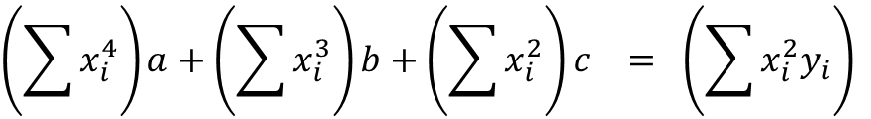
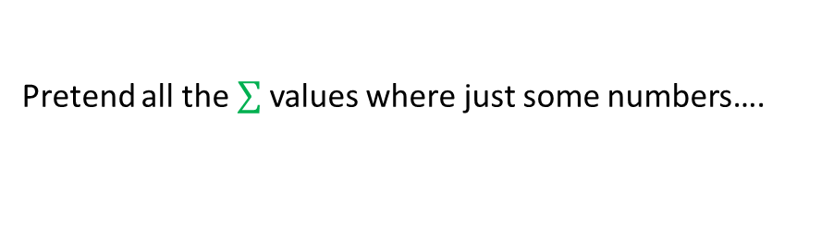
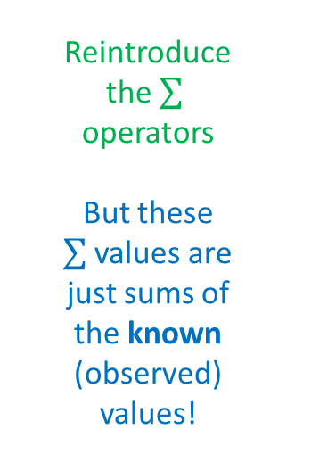
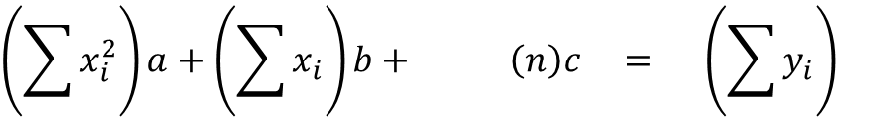
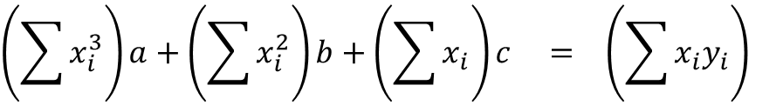
Lab 5 - Method of Least Squares
$$Minimize S= \sum_{i=1}^{n}{{\left[y_{i}−\left(ax_{i}^{2}+bx_{i}+c\right)\right]}^{2}}$$
$$\sum_{i=1}^{n}{\left(1\right)c=\left(n\right)c}$$
Reintroduce the operators
But these values are just sums of the known (observed) values!
$$\left(\sum{x_{i}^{4}}\right)a+\left(\sum{x_{i}^{3}}\right)b+\left(\sum{x_{i}^{2}}\right)c = \left(\sum{x_{i}^{2}y_{i}}\right)$$
$$\left(\sum{x_{i}^{3}}\right)a+\left(\sum{x_{i}^{2}}\right)b+\left(\sum{x_{i}}\right)c = \left(\sum{x_{i}y_{i}}\right)$$
$$\left(\sum{x_{i}^{2}}\right)a+\left(\sum{x_{i}}\right)b+ \left(n\right)c = \left(\sum{y_{i}}\right)$$
Pretend all the values where just some numbers….

Slide 50
Lab 5 - Method of Least Squares
$$Minimize S= \sum_{i=1}^{n}{{\left[y_{i}−\left(ax_{i}^{2}+bx_{i}+c\right)\right]}^{2}}$$
This is a system of 3 linear equations and 3 unknowns!
$$\left(4\right)a+ \left(5\right)b+\left(−2\right)c=\left(−14\right)$$
$$\left(7\right)a+\left(−1\right)b+ \left(2\right)c= \left(42\right)$$
$$\left(3\right)a+ \left(1\right)b+ \left(4\right)c= \left(28\right)$$

Slide 51
Lab 5 - Method of Least Squares
$$Minimize S= \sum_{i=1}^{n}{{\left[y_{i}−\left(ax_{i}^{2}+bx_{i}+c\right)\right]}^{2}}$$
This is a system of 3 linear equations and 3 unknowns!
$$\left(\sum{x_{i}^{4}}\right)a+\left(\sum{x_{i}^{3}}\right)b+\left(\sum{x_{i}^{2}}\right)c = \left(\sum{x_{i}^{2}y_{i}}\right)$$
$$\left(\sum{x_{i}^{3}}\right)a+\left(\sum{x_{i}^{2}}\right)b+\left(\sum{x_{i}}\right)c = \left(\sum{x_{i}y_{i}}\right)$$
$$\left(\sum{x_{i}^{2}}\right)a+\left(\sum{x_{i}}\right)b+ \left(n\right)c = \left(\sum{y_{i}}\right)$$
See Session 10:
Coefficient Matrix
Value Vector

Slide 52
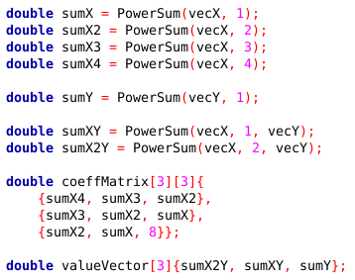
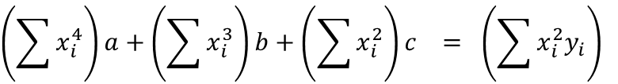
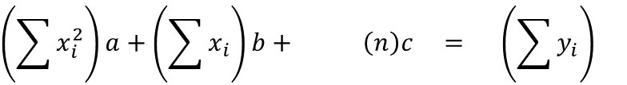

Open Lab 5 - Method of Least Squares
$$Minimize S= \sum_{i=1}^{n}{{\left[y_{i}−\left(ax_{i}^{2}+bx_{i}+c\right)\right]}^{2}}$$
$$\left(\sum{x_{i}^{4}}\right)a+\left(\sum{x_{i}^{3}}\right)b+\left(\sum{x_{i}^{2}}\right)c = \left(\sum{x_{i}^{2}y_{i}}\right)$$
$$\left(\sum{x_{i}^{3}}\right)a+\left(\sum{x_{i}^{2}}\right)b+\left(\sum{x_{i}}\right)c = \left(\sum{x_{i}y_{i}}\right)$$
$$\left(\sum{x_{i}^{2}}\right)a+\left(\sum{x_{i}}\right)b+ \left(n\right)c = \left(\sum{y_{i}}\right)$$
We have 8 sample points in the Lab 5 data set

Slide 53


View Lab 5 - Method of Least Squares
$$y=ax^{2}+bx+c$$
yp = y predicted
"the estimated y value"

Slide 54


Run Lab 5 - Method of Least Squares
$$y=10.4643x^{2}+194.2262x+0.1429$$

Slide 55

Verify Lab 5 - Method of Least Squares
via Difference Tables
via Least Squares
$$y=10.5833x^{2}+193.1786x+1.8214$$
$$y=10.4643x^{2}+194.2262x+0.1429$$
10x better!
The method of least squares guarantees the best possible fit between the observed data and the polynomial form chosen to model the data

Slide 56
Now you know…
Model fitting starts by assuming the degree of an appropriate curve that reasonably matches the data
How to create difference tables for constant, linear, quadratic, cubic, and quartic terms along with their expected average
Gauss’s Method of Least Squares refers to shaping the approximating curve to minimize the total deviations between the observed data and points on that curve
The function to minimize must be expanded, and then partial derivatives must be found for each coefficient of the curve
Matrix algebra (Cramer's Rule) can then solve for the coefficients
The % relative error measures the “goodness of fit” of a model to experimental observations

